Slide 1
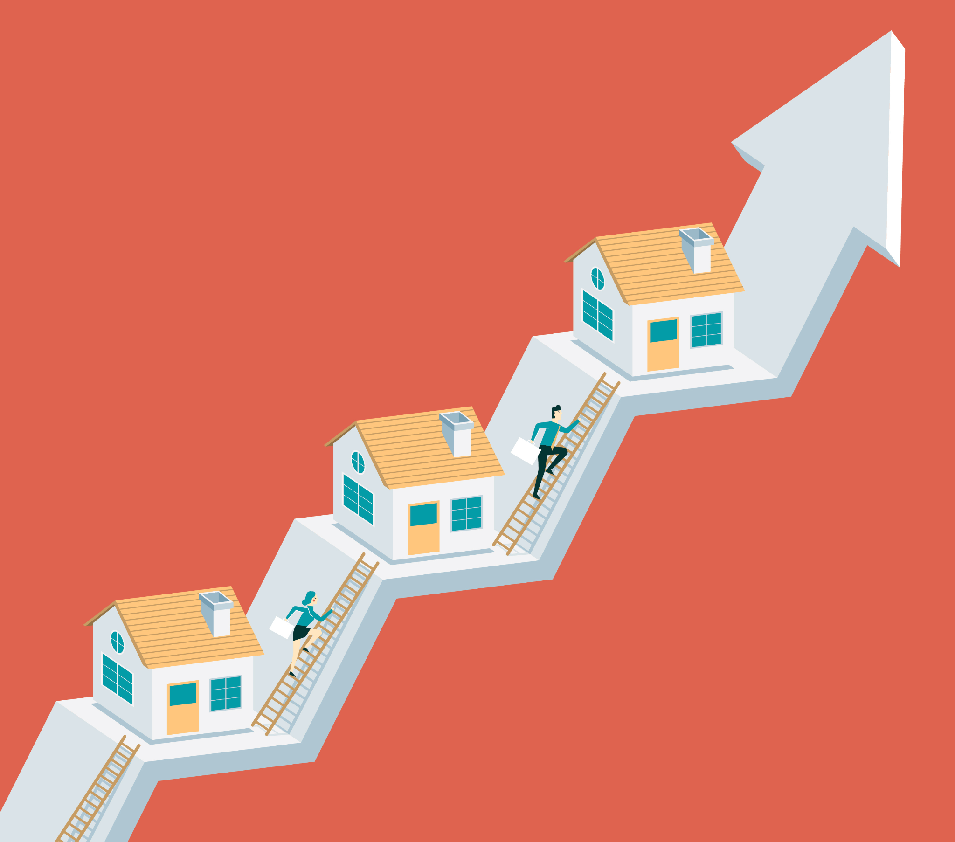
TORONTO HOUSING MARKET
AFFORDABILITY REMAINS AT A CRISIS LEVEL
By Chu, Andreza and Sameen
Notes:
Sameen

Slide 2

Starting a family in Ontario
As a new family finding a new home and wanting to raise kids in Canada there are many factors that must be met. Ontario came up as an ideal location due to its bustling environment and opportunities for growth. But which city is the best suited for a young family in Ontario?
Every family most likely will say that the amenities around the area such as schools, healthcare locations, and daycares are key considerations in any case.
It is necessary to dive deeper into the housing market in Ontario to ensure that we provide our kids with the support and care they need to become successful individuals.
Notes:
Sameen

Slide 3
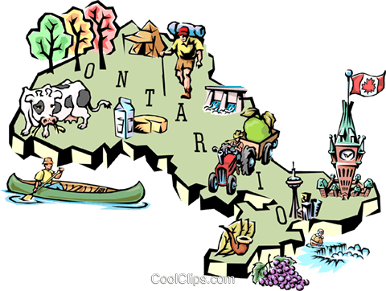
Some things to consider while starting a family
What are the TOP Housing Markets in Ontario?
How do these prices fluctuate between different cities in Ontario and GTA?
Expensive vs Cheapest areas to buy a House within GTA.
How do Amenities contribute to the inflated House prices in and around GTA?
Notes:
Sameen

Slide 4
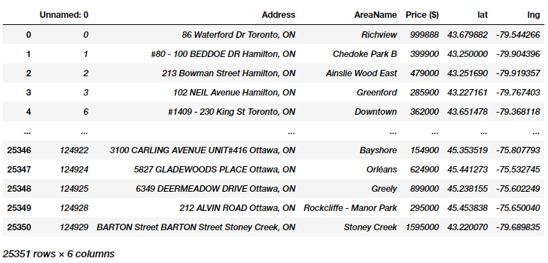
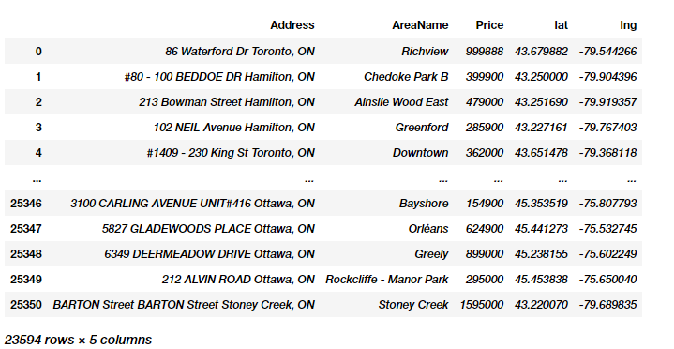
Data Source
Dataset - Kaggle (https://www.kaggle.com/datasets/mnabaee/ontarioproperties)
Initial data
Final data
Notes:
Sameen

Slide 5
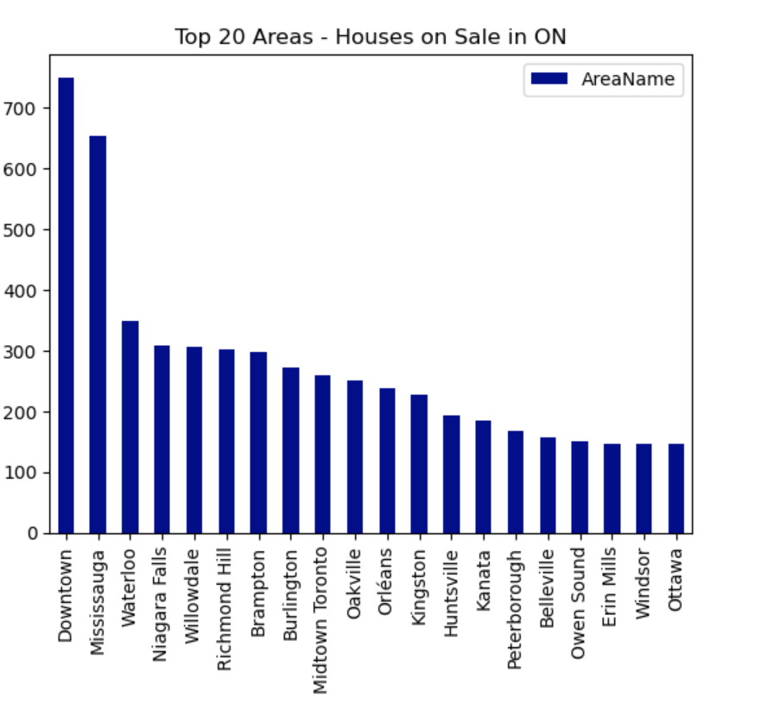
Taking a look at Ontario’s Top Housing Markets
The chart represents the
TOP 20 Rank by area with highest # of Houses listed for sale in ONTARIO
with Downtown Toronto and Mississauga having almost double the listings compared to other cities across Ontario
# of House Listings
Area Names
Notes:
Sameen

Slide 6
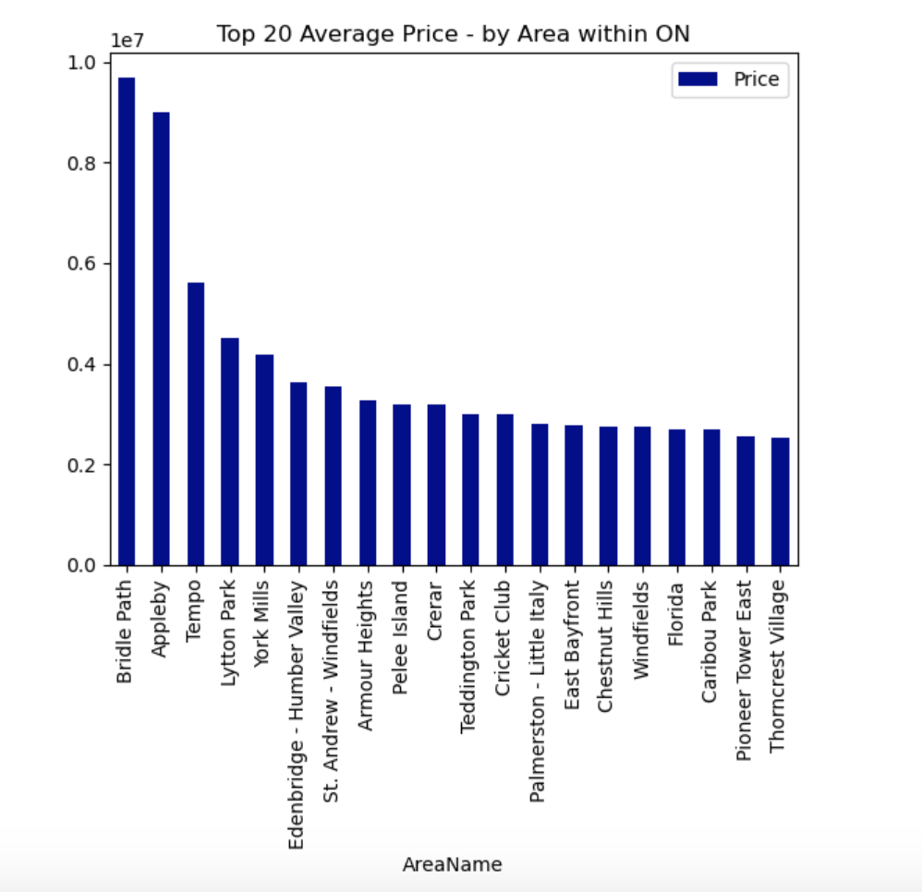
Areas with Highest Average Price
The chart represents the
TOP 20 Rank by area with highest AVERAGE PRICE in ONTARIO
with Bridal Path and Appleby having most expensive houses on the market
Notes:
Sameen

Slide 7
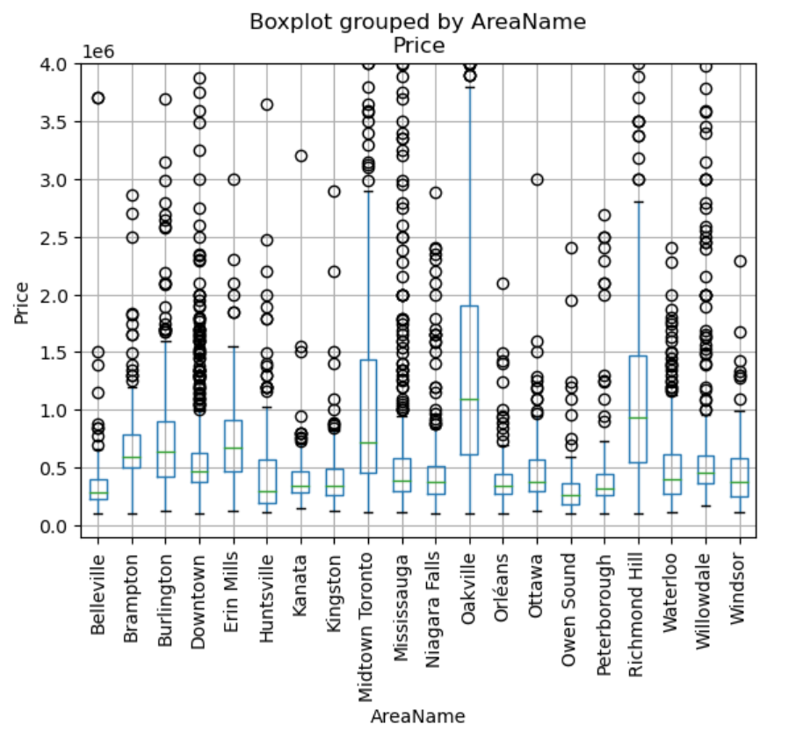
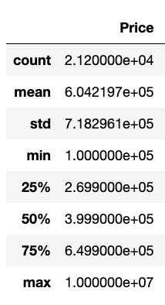
OUTLIERS AND WHAT THEY TELL US
Notes:
Sameen

Slide 8
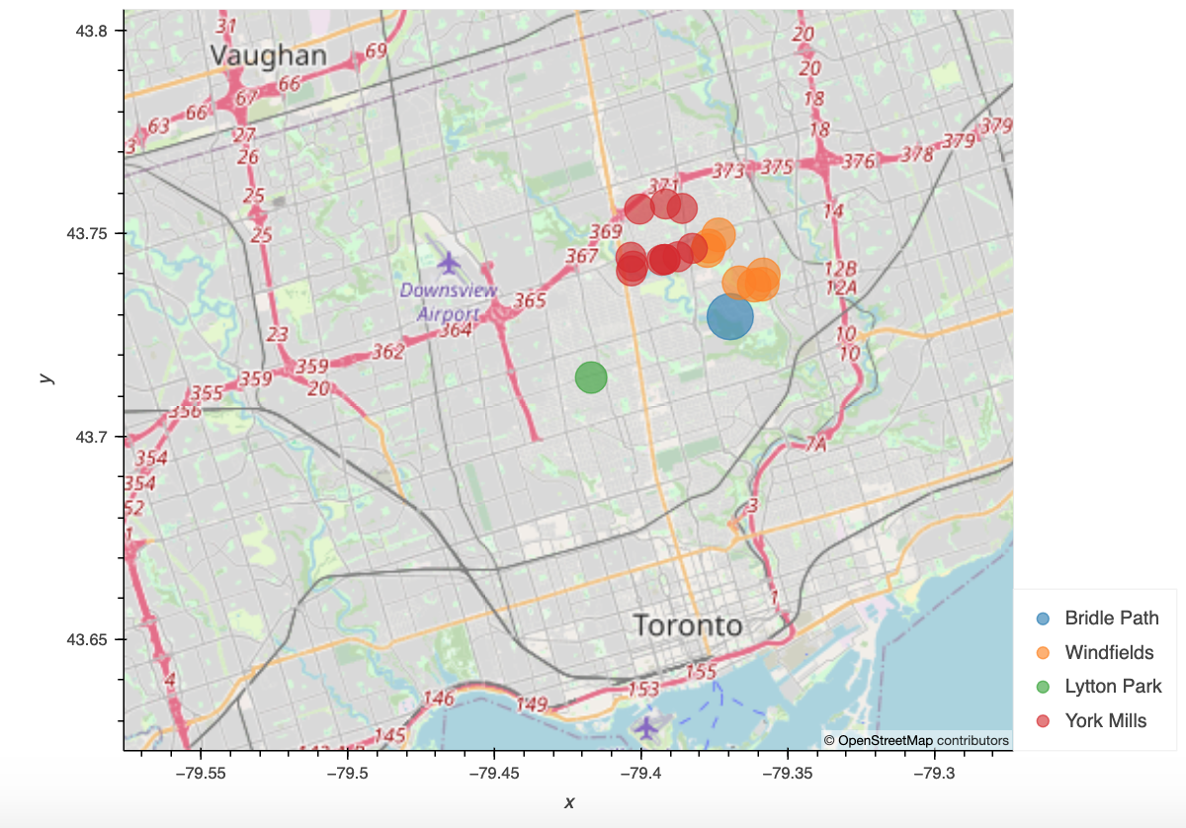
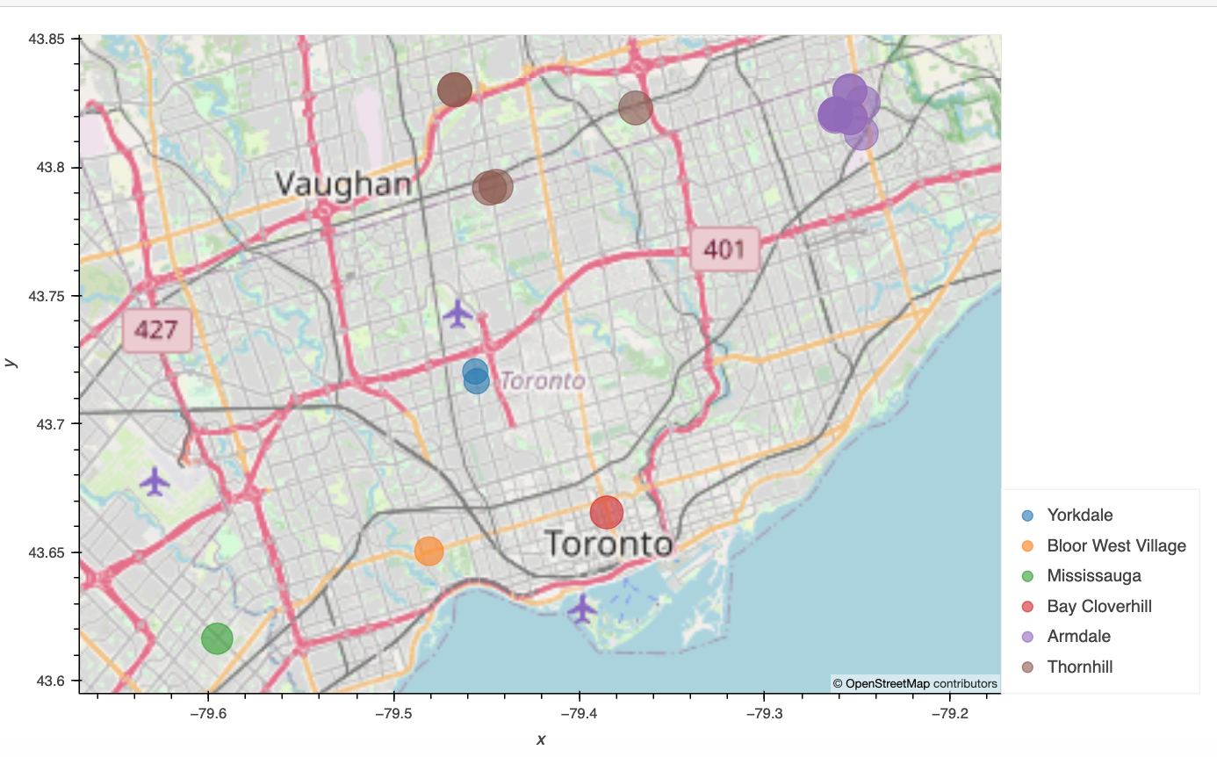
MAPPING TORONTO
Top 20 Residential Houses
Top 20 Residential Areas
Notes:
Andeza

Slide 9
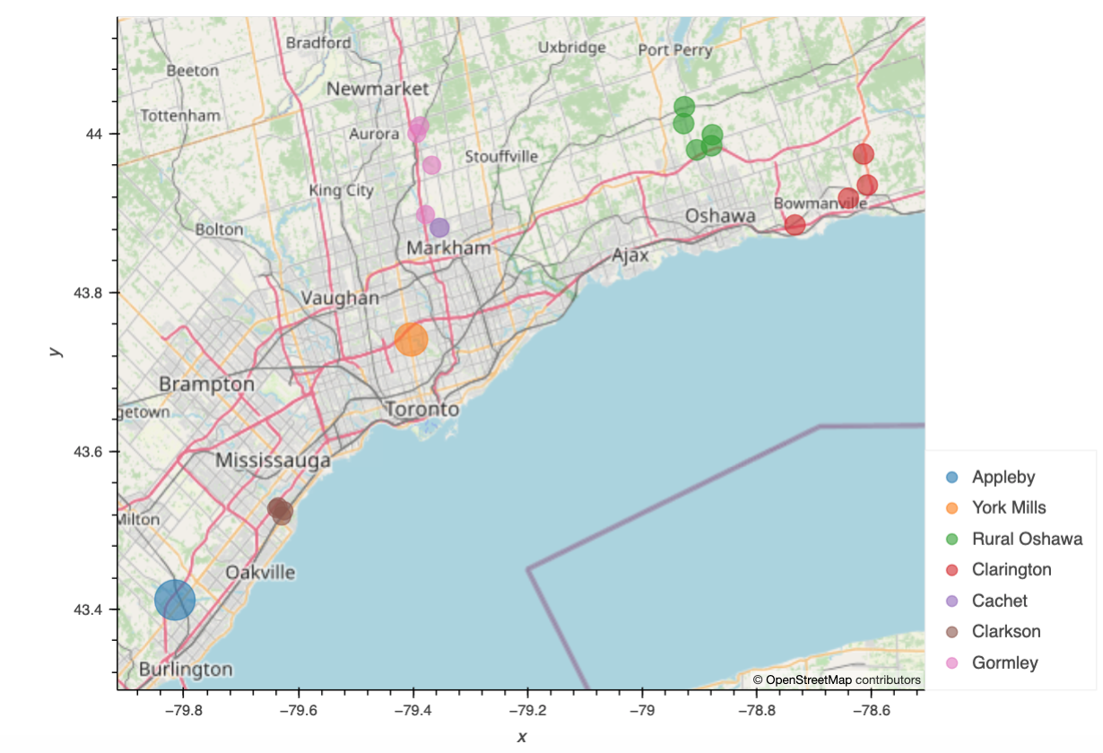
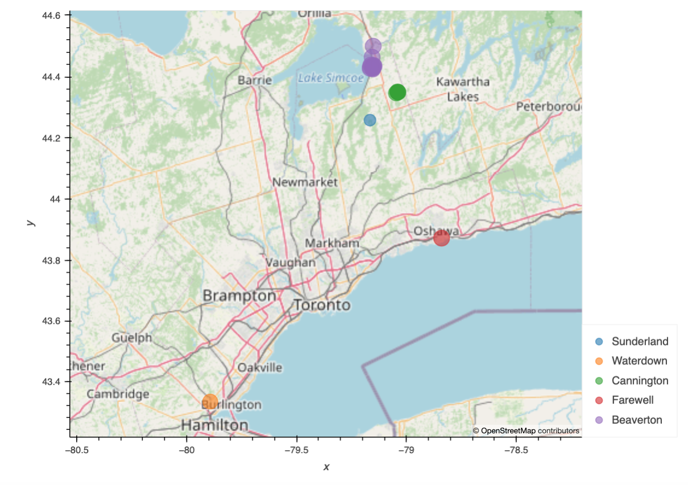
MAPPING GTA
TOP 20 AREAS
BOTTOM 20 AREAS
Notes:
Andeza

Slide 10
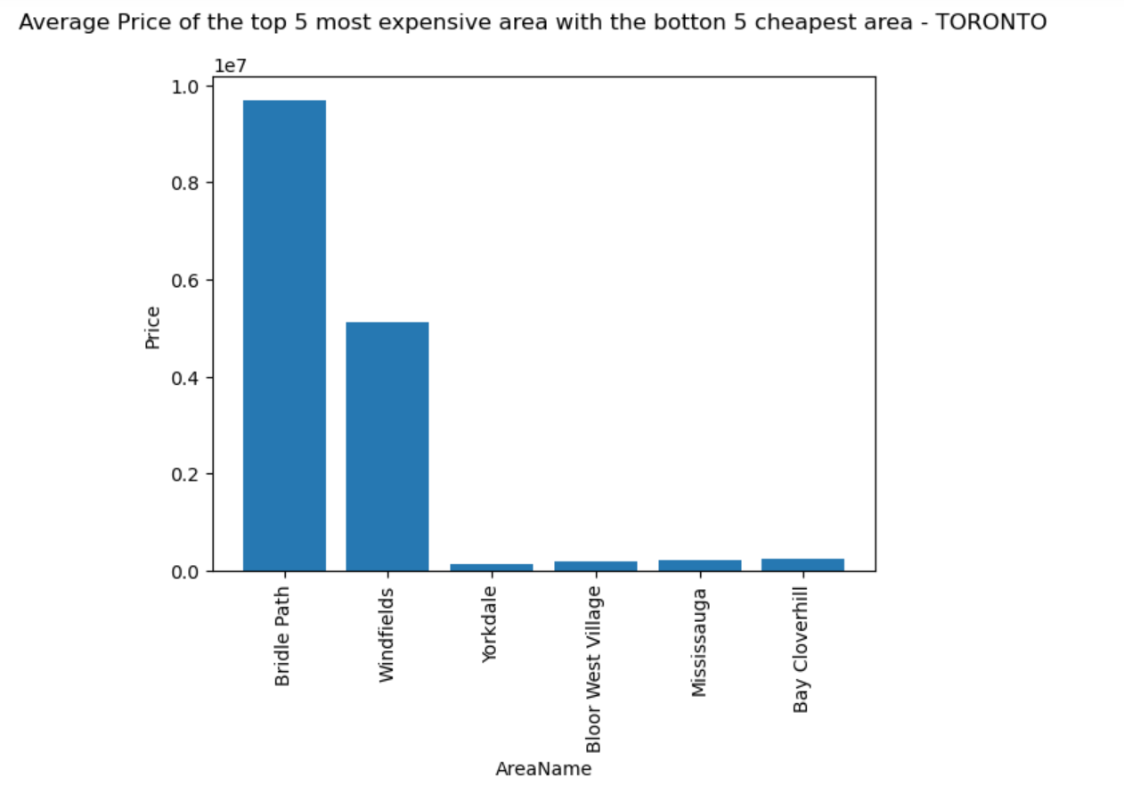
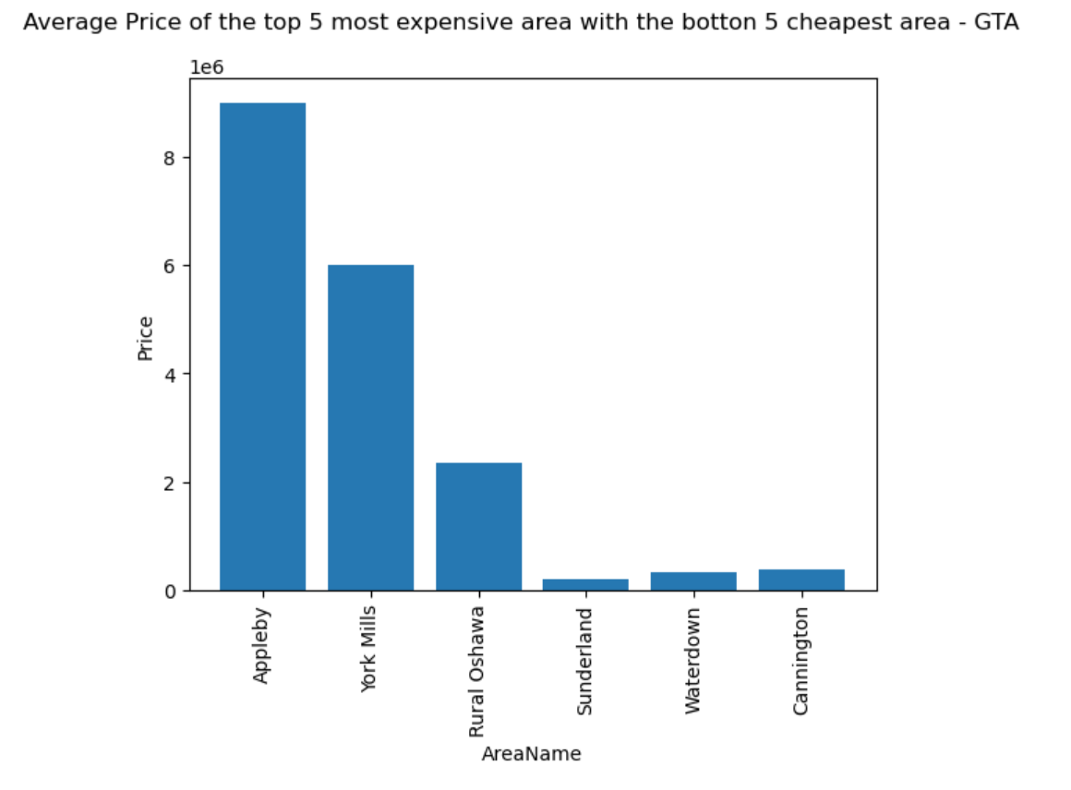
Average Price of the top 5 most expensive area vs bottom 5 cheapest area

Slide 11
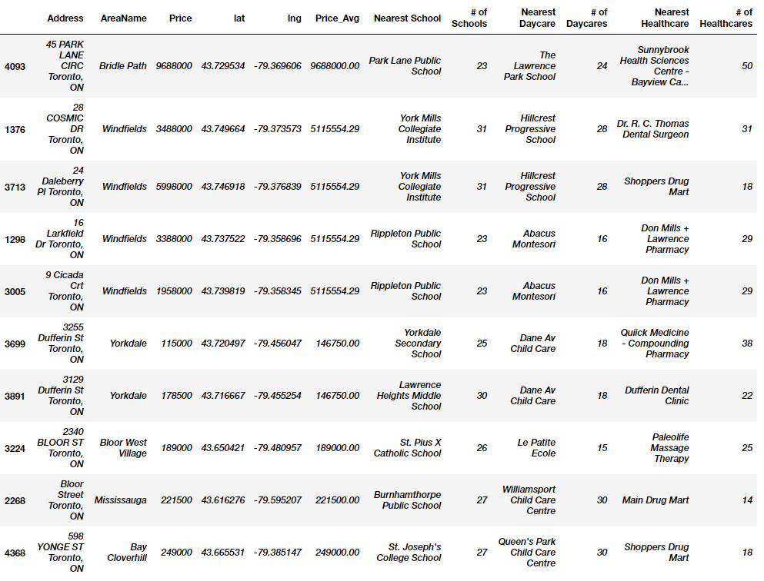
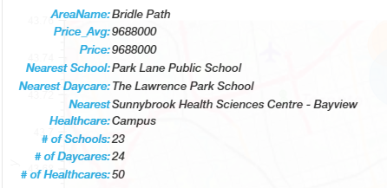
AMENITIES
in Toronto Area
Notes:
Chu

Slide 12
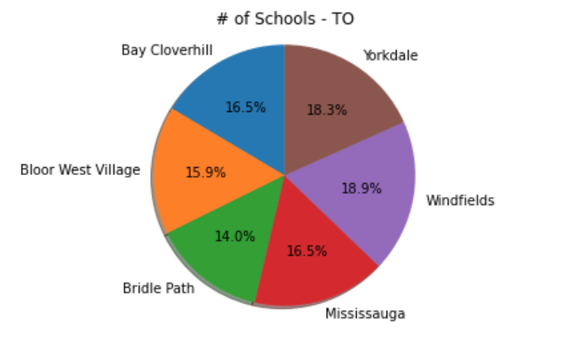
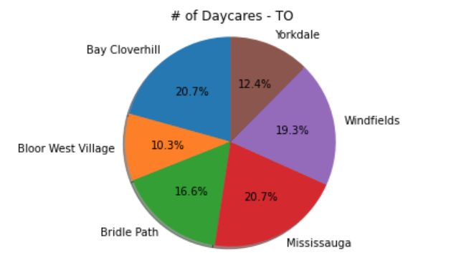
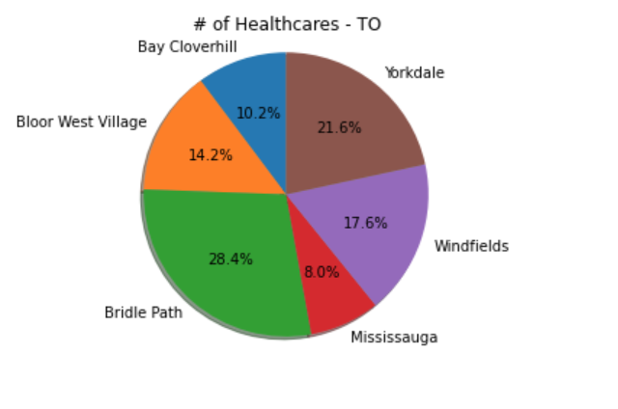
AMENITIES IN TORONTO

Slide 13
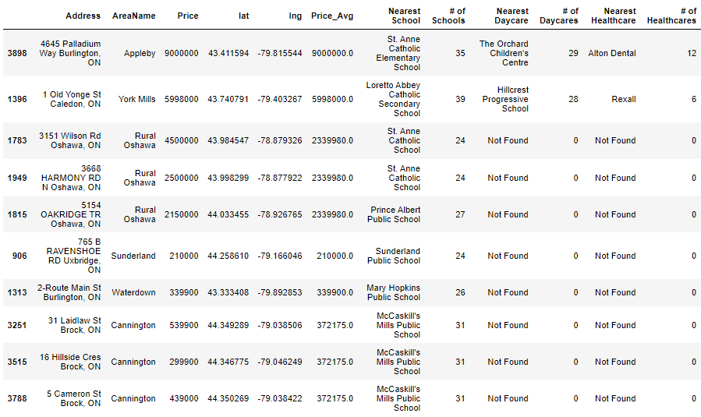
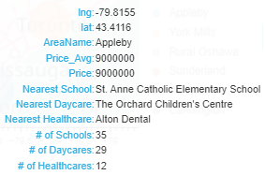
AMENITIES
in GTA
Notes:
Chu

Slide 14
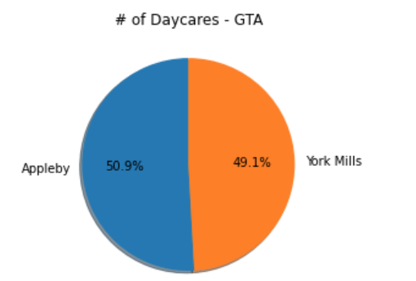
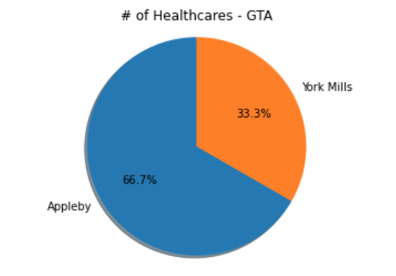
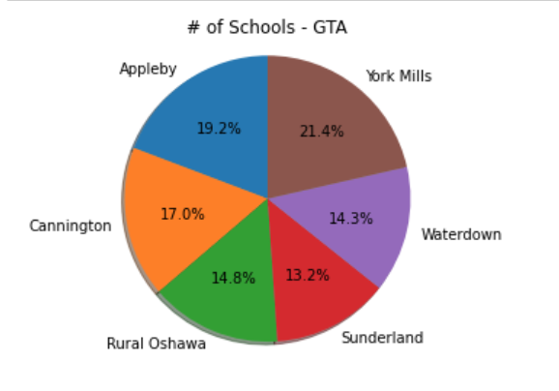
AMENITIES IN GTA

Slide 15
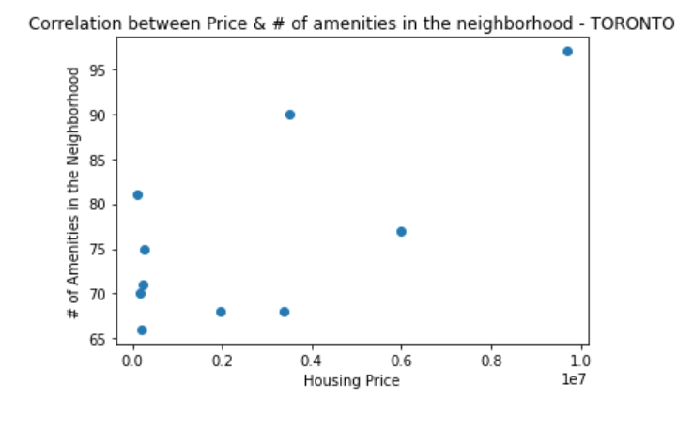
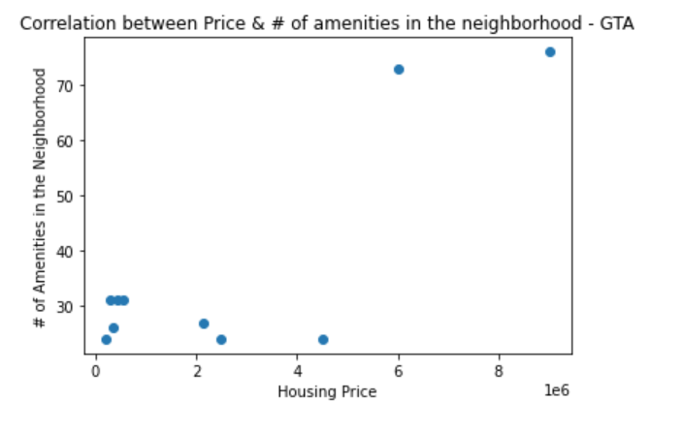
Correlation Price & # of Amenities in the neighborhood
The correlation between both factors is 0.69
The correlation between both factors is 0.82

Slide 16
Conclusion
Average price of a House in Ontario has been calculated to be ~$600,000
Areas including Downtown Toronto, Mississauga, Waterloo, Niagara Falls are the Top housing markets of Ontario.
Amenities are relatively equally distributed amongst Toronto region regardless of the housing values
However, the cheapest areas in GTA do not have healthcare neither daycare within 10km radius.
Things to consider:
Understand Housing market based on different types of Houses’ i.e., Detach vs. Semi vs. Town-Houses
Correlating average household income to average House Prices

